Slide 1
Decision Tree

Slide 2
Decision Tree
A Visual Representation of Choices, Consequences, Probabilities, and Opportunities. • A Way of Breaking Down Complicated Situations Down to Easier-to-Understand Scenarios. • By applying - Logic - Likely Outcome - Quantitative decision

Slide 3
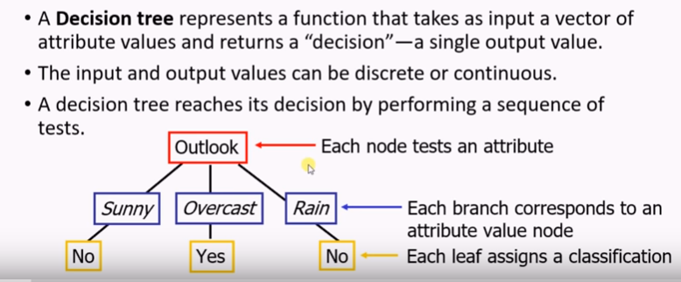
Decision Tree Learning

Slide 4
Properties
Non-linear classifier
Easy to use
Easy to interpret
Susceptible to overfitting but can be avoided.

Slide 5
Using Decision Trees
■ Scientific analysis to decision making  visual aids to structure  solve sequential decision problems  Especially beneficial when the complexity of the problem grows  Useful for operational decision making  Encourage clear thinking and planning

Slide 6
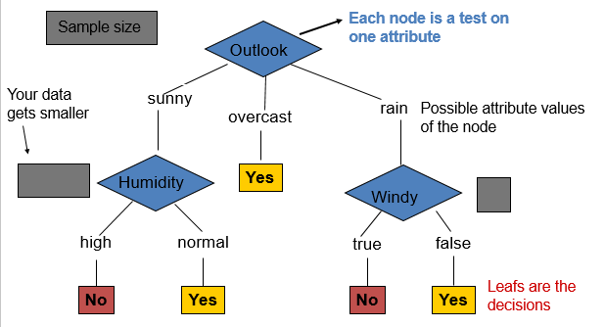
Anatomy of a decision tree

Slide 7
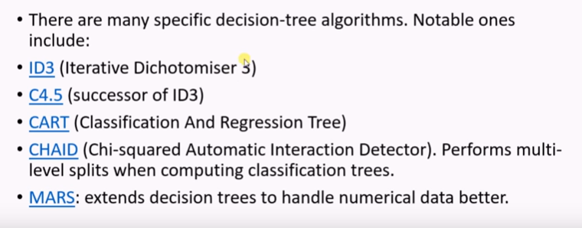
Decision Tree Learning Algorithms

Slide 8
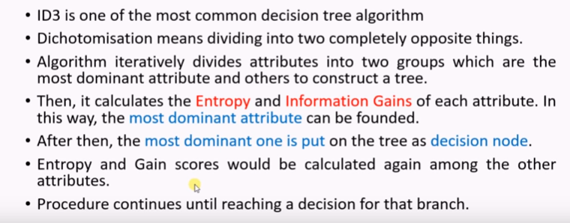
ID3 Algorithm

Slide 9
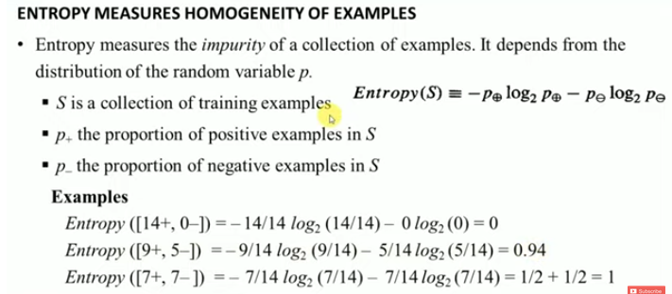
Entropy

Slide 10
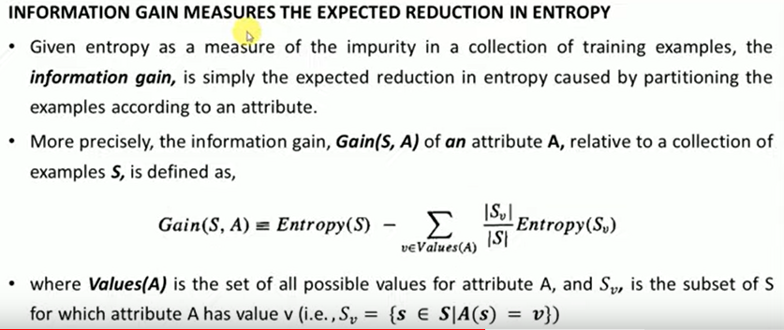
Information gain

Slide 11
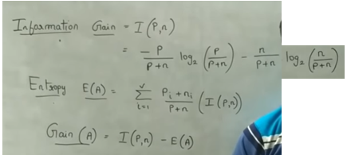

Slide 12
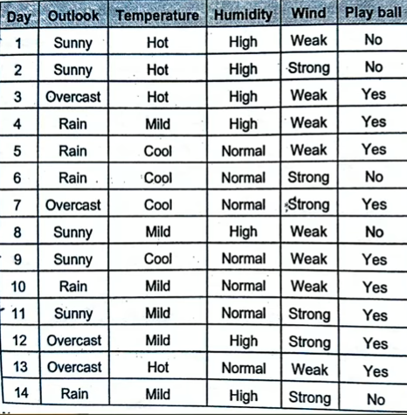
Example
Play ball->P=9(Yes) & n=5(No)

Slide 13
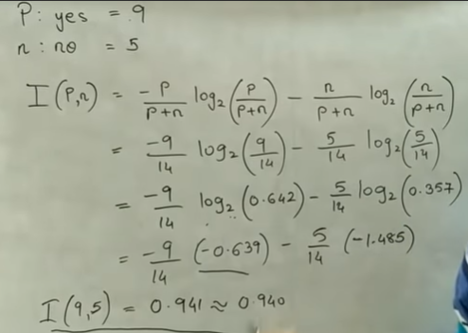
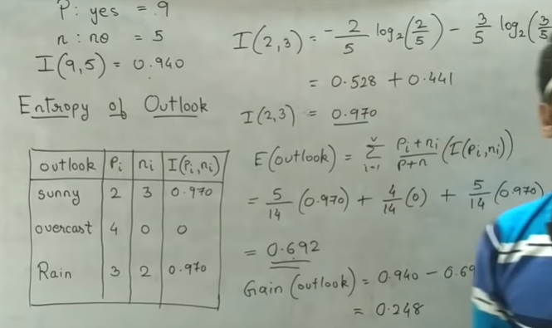

Slide 14
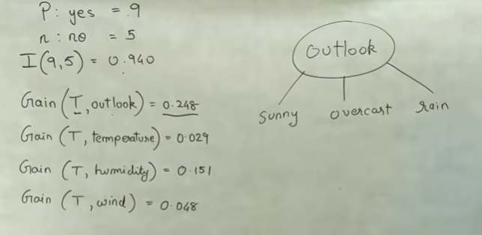

Slide 15
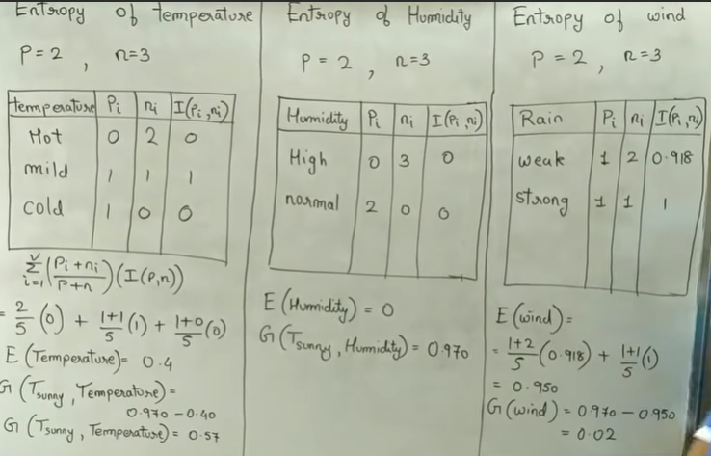
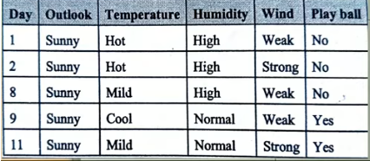

Slide 16
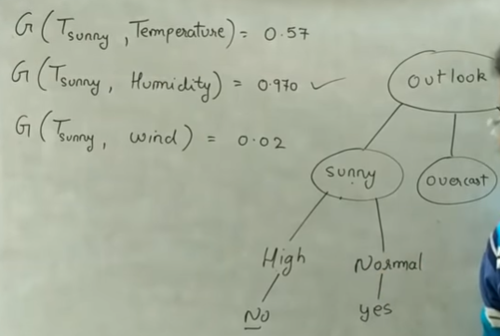
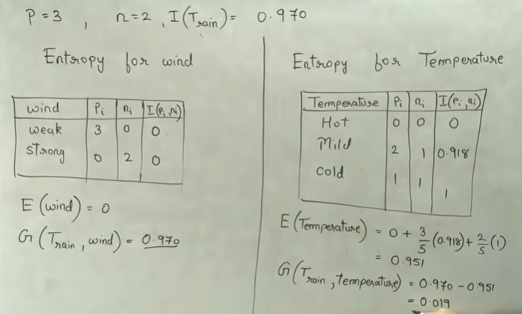

Slide 17
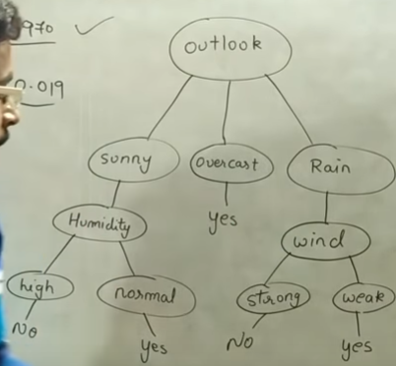
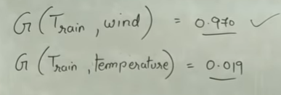

Slide 18
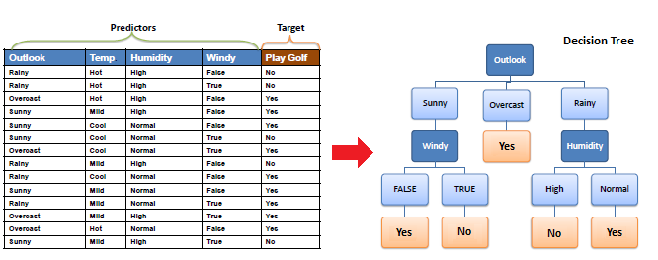

Slide 19
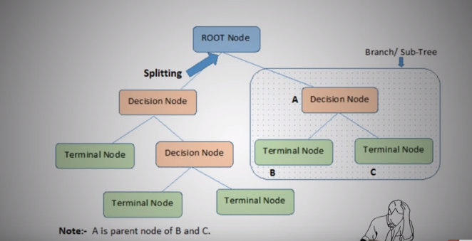
CART Algorithm

Slide 20
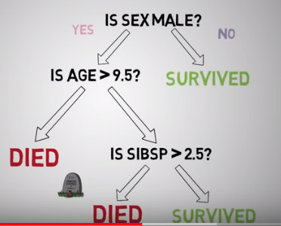

Slide 21
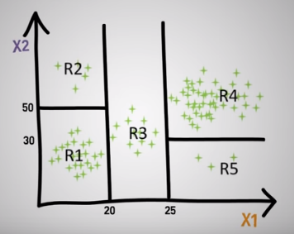
Example

Slide 22
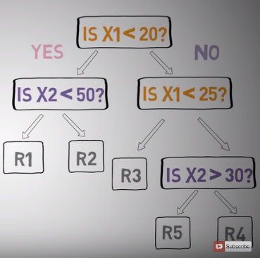

Slide 23
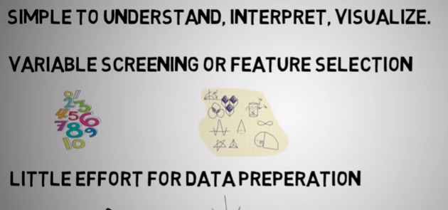
Pros of DT

Slide 24
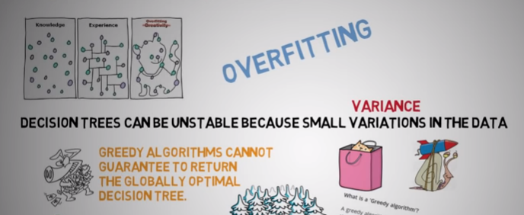
Cons of DT

Slide 25
Decision Tree Limitations
■ local optimal solution not global optimal solution  Possibility of duplication with the same sub-tree on different paths  Possibility of spurious relationships

Slide 26
Reference
https://www.youtube.com/watch?v=cKl7WV_EKDU&list=PLHmN7Pq-WTcz3F1pY3IzcZlJyS05jASob
https://www.youtube.com/watch?v=DCZ3tsQIoGU&list=PLHmN7Pq-WTcz3F1pY3IzcZlJyS05jASob&index=2

